Slide 1

Data-Driven Estimation of Obesity Risk from Lifestyle Habits
PRESENTED BY
VIVEK PAL
ENROLLMENT NO.- 6101905164

Slide 2
Introduction
Obesity is a rising global health concern, influenced by lifestyle and behavior.
The project uses ML models to predict and classify obesity levels from individual lifestyle data.
Achieved over 90% accuracy with classification models.
Regression models predicted BMI with high R².
K-Means clustering identified lifestyle patterns among individuals.
Traditional obesity diagnosis relies on BMI but ignores behavioral factors.
Machine learning provides a modern, data-driven approach.
Goal: Predict obesity levels based on lifestyle features like diet, exercise, and habits.

Slide 3
About Dataset
Source: Kaggle (UCI Obesity Dataset)
Total features: 17 (age, weight, height, dietary habits, activity, smoking, alcohol, etc.)
Combination of categorical and numerical data types.
Dataset LinK: https://www.kaggle.com/code/mpwolke/obesity-levels-life-style/input

Slide 4
Machine Learning Model
TASK | ALGORITHMS USED
Classification | Logistic Regression, KNN, Decision Tree, SVM, RF
Regression | Linear, Lasso, Ridge, Decision Tree, Random Forest
Clustering | K-means Clustering

Slide 5
Best Fit Model
Model | Result
Classification- Random Forest | 91%(Accuracy) Insight: Random Forest gave the best accuracy
Regression- Random Forest | 7.18(RMSE), 093(R² Score) Insight: RF Regressor best fits BMI prediction (lowest error, highest R²).
Clustering- (K-Means) | Cluster 2: 44 Insight: Cluster 2 = rare profile; might indicate outliers or unique behaviors.

Slide 6
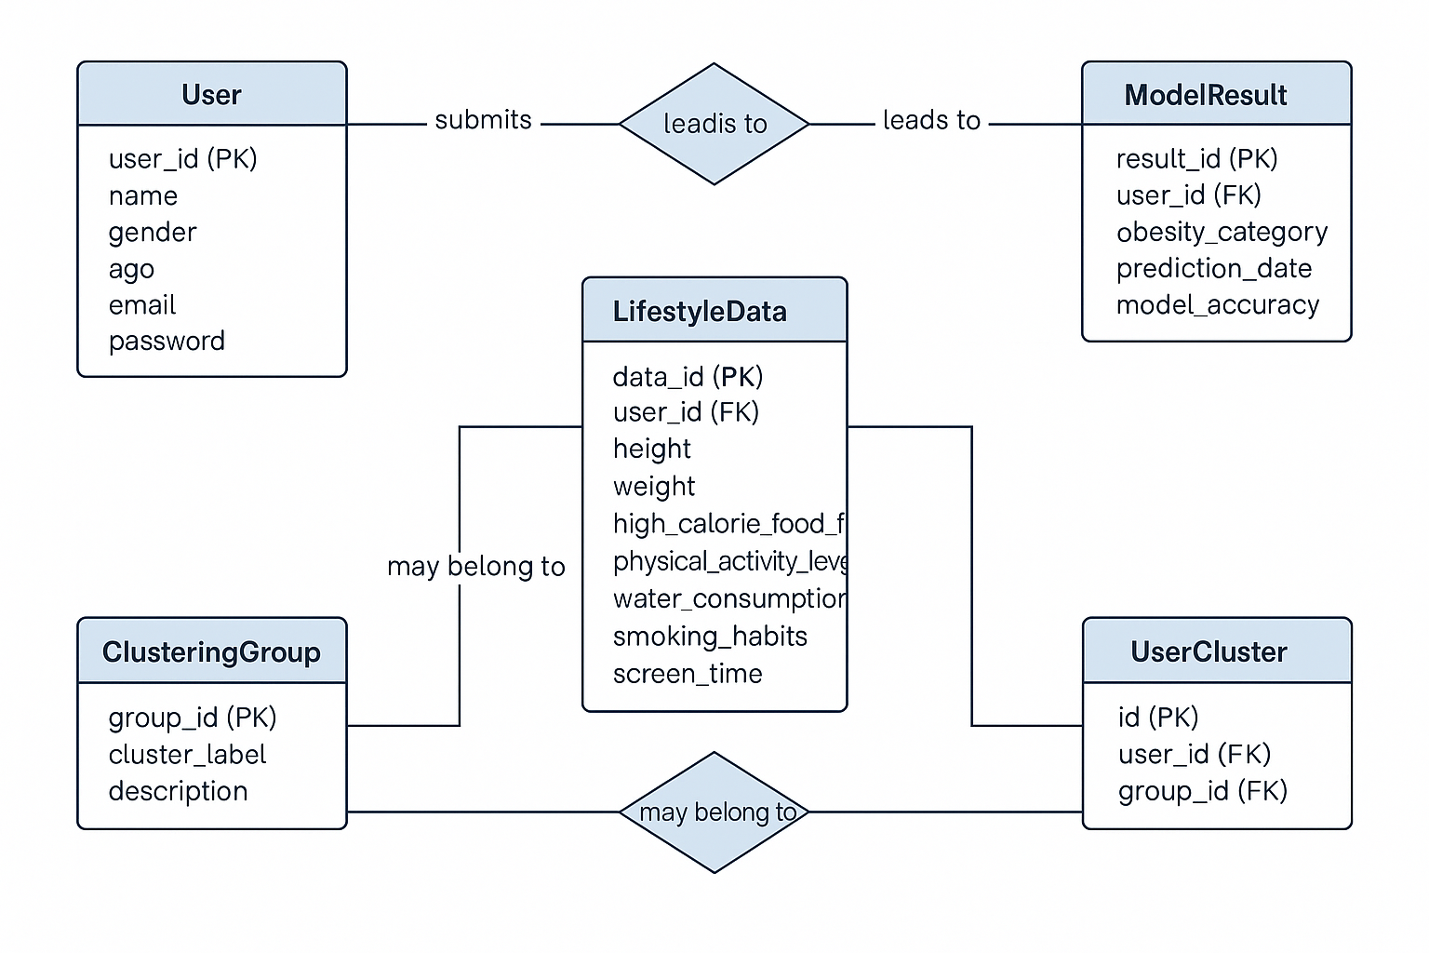
Entity Relationship Diagram

Slide 7
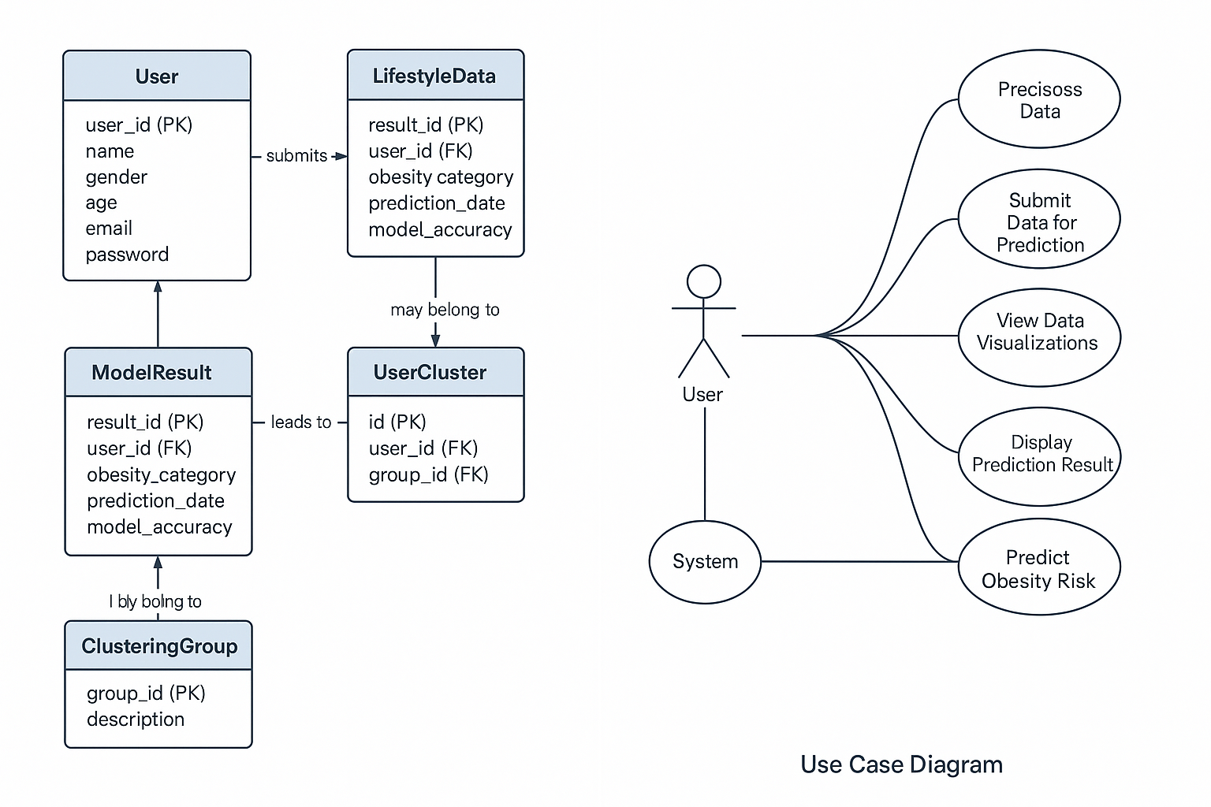
Use Case Diagram

Slide 8
Observations
Random Forest was the best for both classification and regression.
Linear models performed moderately; not suitable for complex patterns.
Clustering reveals hidden lifestyle groups that correlate with obesity.
Some obesity categories (e.g., Obesity Type II) were easier to detect.

Slide 9
Conclusion
ML can effectively estimate obesity risk based on behavioral and lifestyle inputs.
Random Forest showed superior performance in both prediction and classification.
Clustering highlighted distinct groups with similar obesity tendencies.
This approach helps pave the way for personalized health interventions.

Slide 10
Future Work
Integrate time-series data (e.g., wearable trackers).
Use deep learning models for even better prediction accuracy.
Develop a web or mobile app for public use.
Add more features like sleep patterns, stress levels, etc.

Slide 11
THANK YOU

